Slide 1





ABP Community News
What’s new with the latest ABP?
Alper EBICOGLU
@alperebicoglu
ABP Core Team Member
@ebicoglu

Slide 2

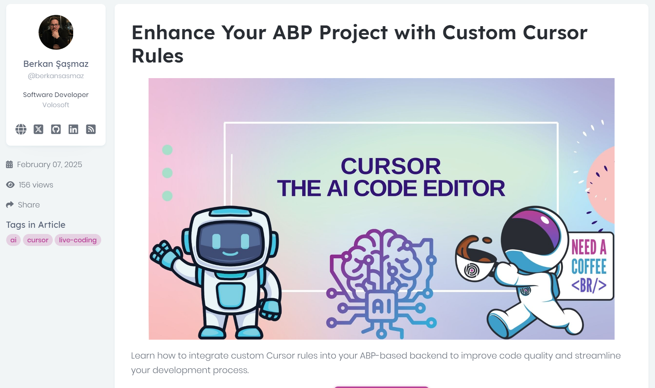
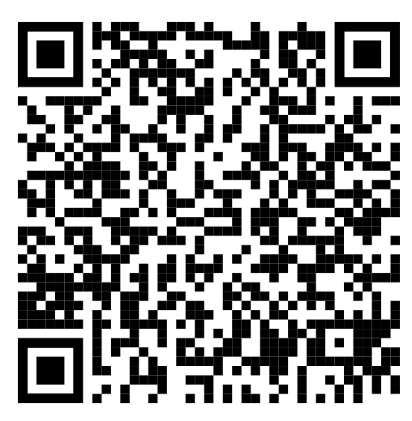
Community News
https://abp.io/community/articles/enhance-your-abp-project-with-custom-cursor-rules-pzwxzumo
Notes:
integrate custom Cursor rules into your ABP-based backend to improve code quality and streamline your development process.

Slide 3
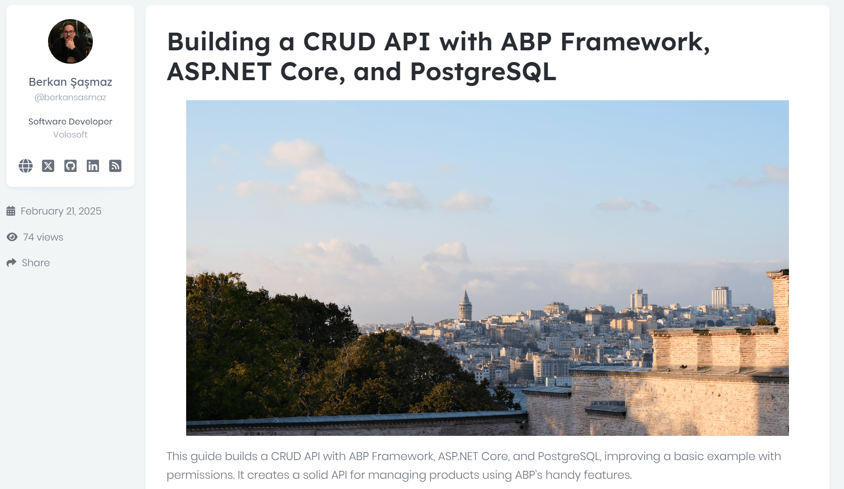
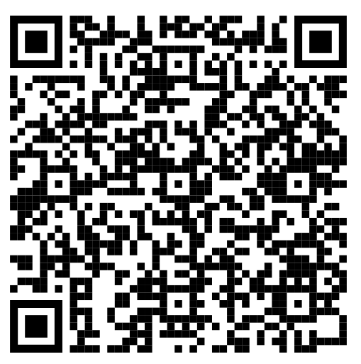
Community News
https://abp.io/community/articles/building-a-crud-api-with-abp-framework-asp.net-core-and-postgresql-elrj0old
Notes:
Create a CRUD API with ABP Framework, ASP.NET Core, and PostgreSQL, improving a basic example with permissions. It creates a solid API for managing products using ABP’s handy features.

Slide 4
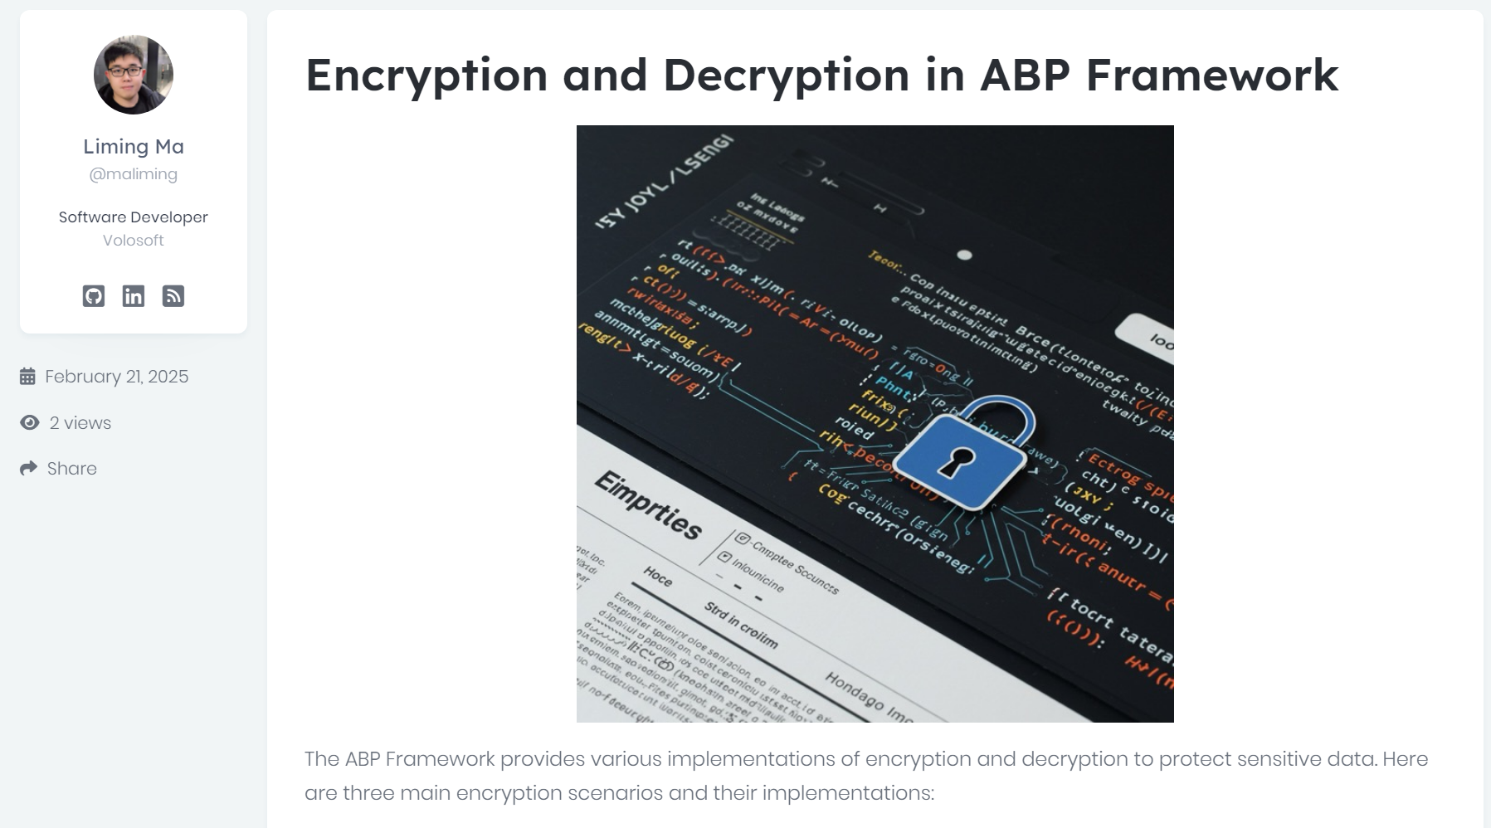
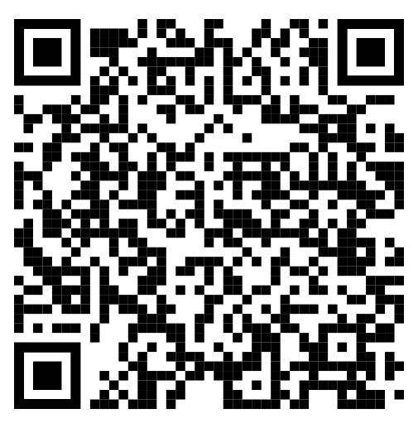
Community News
https://abp.io/community/articles/encryption-and-decryption-in-abp-framework-37uqhdwz
Notes:
The ABP Framework provides various implementations of encryption and decryption to protect sensitive data. Here are three main encryption scenarios and their implementations:

Slide 5
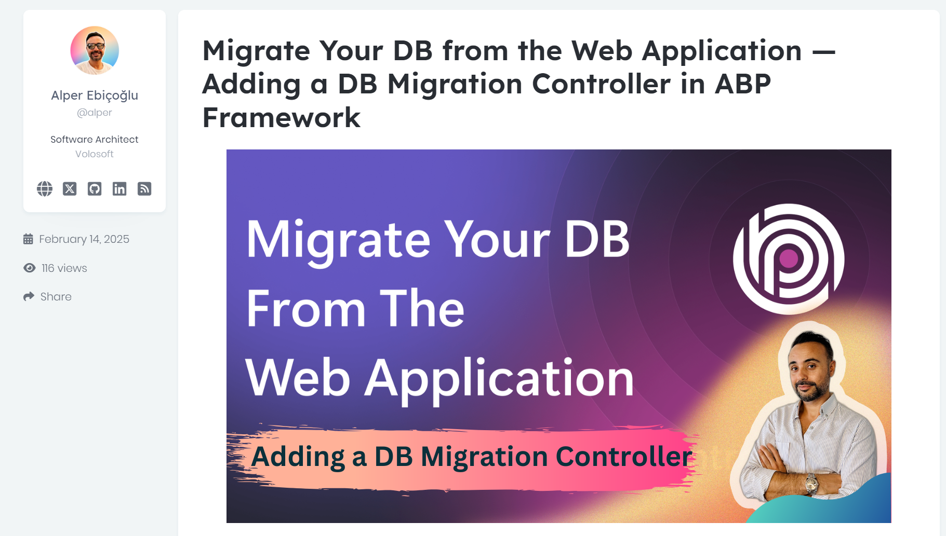
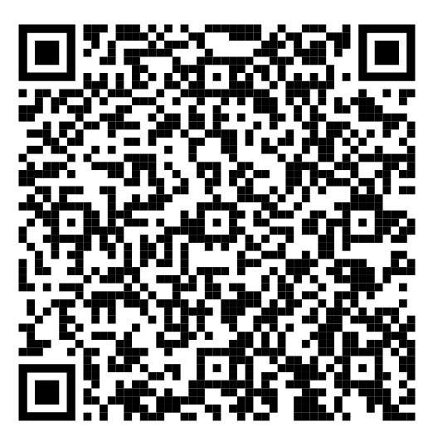
Community News
https://abp.io/community/articles/x3u3uvk3

Slide 6
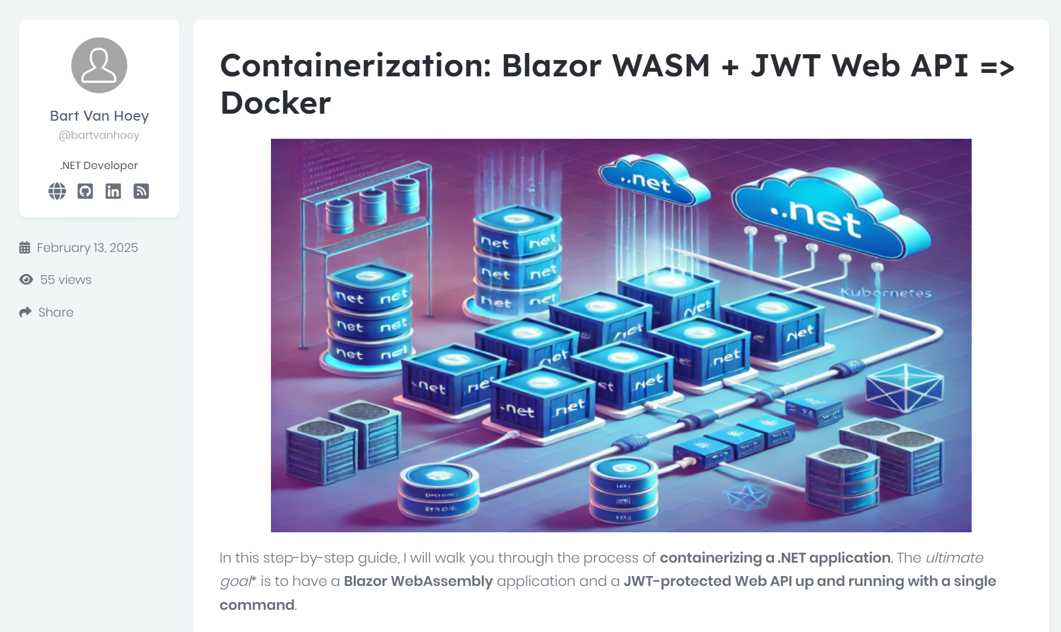
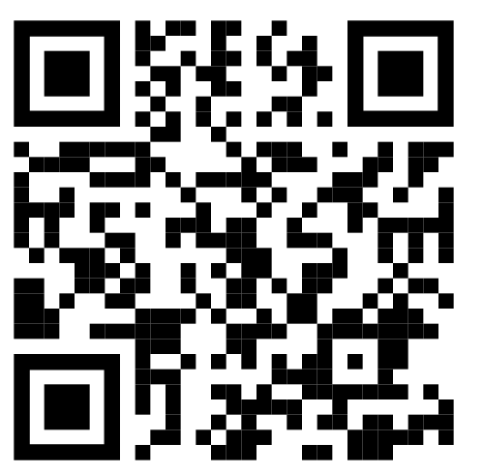
Community News
https://abp.io/community/articles/i3eirlsf
Notes:
I will walk you through the process of containerizing a .NET application. The ultimate goal is to have a Blazor WebAssembly application and a JWT-protected Web API up and running with a single command.

Slide 7
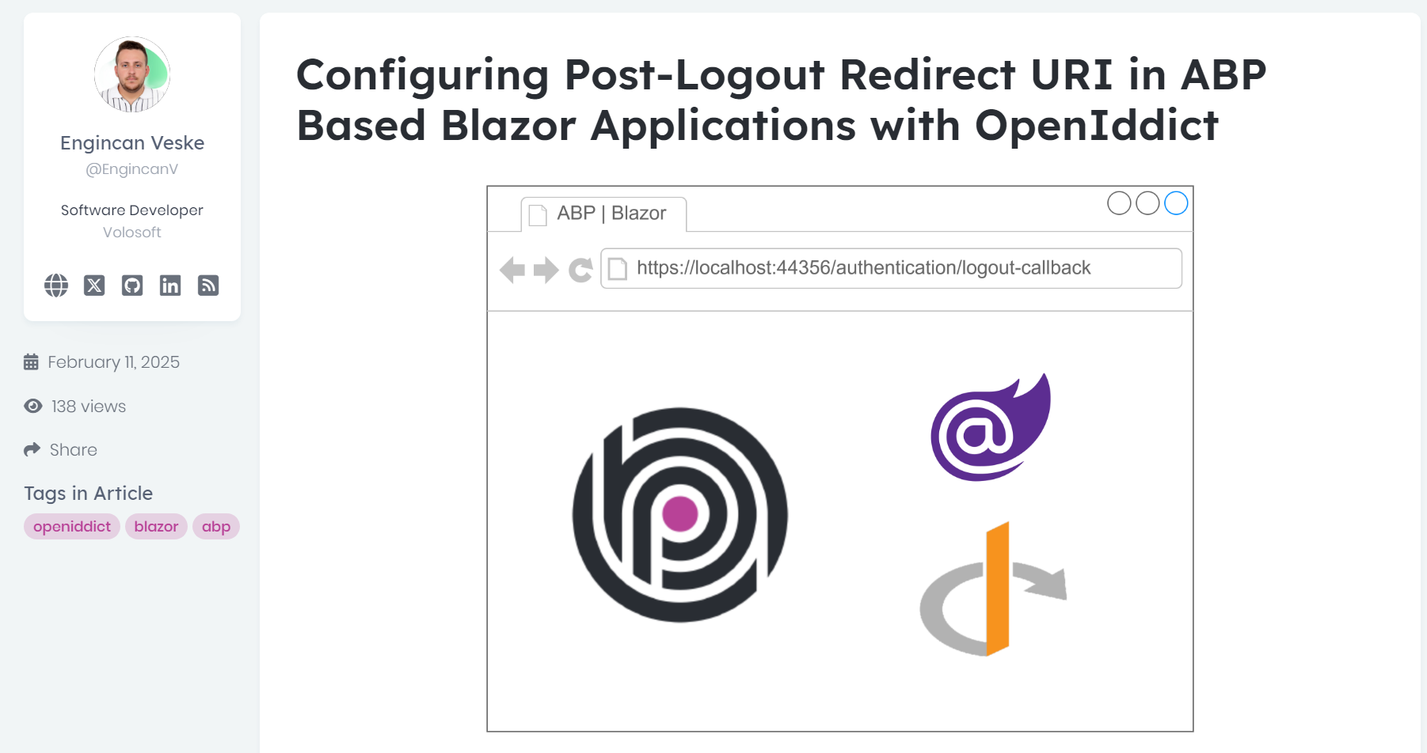
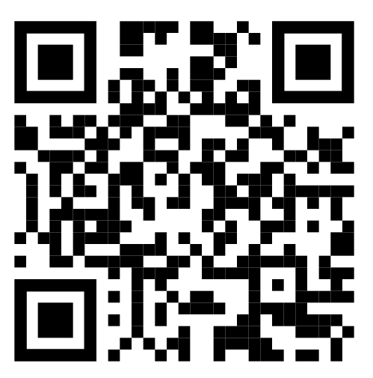
Community News
https://abp.io/community/articles/1t84suxg
Notes:
OpenIddict module provides authentication features like single sign-on, single log-out, and API access control. While it comes pre-installed in ABP applications, the default post-logout redirect URI (/authentication/logout-callback) shows a generic logout page.

Slide 8

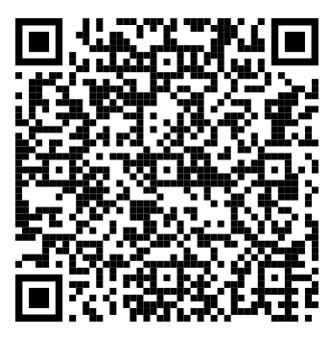
How to get the discount? 👉

Slide 9
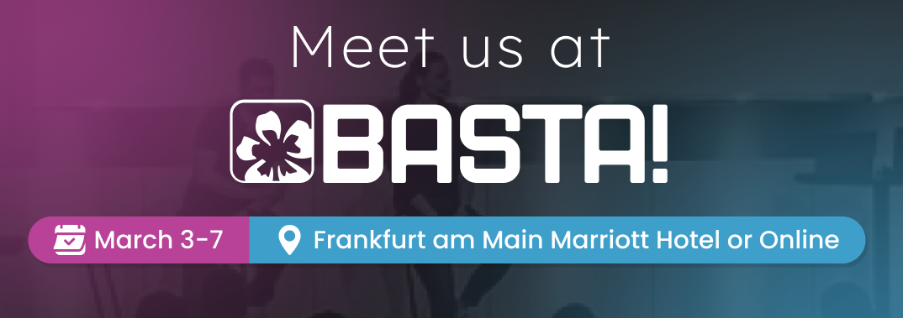
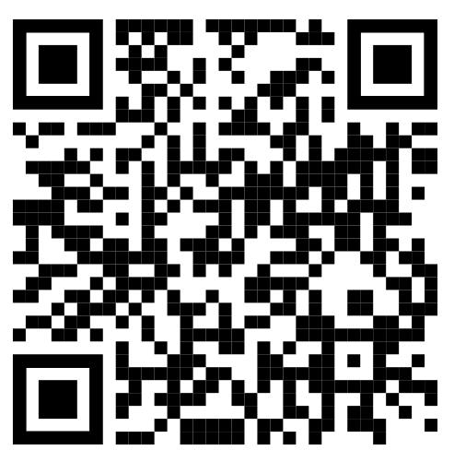
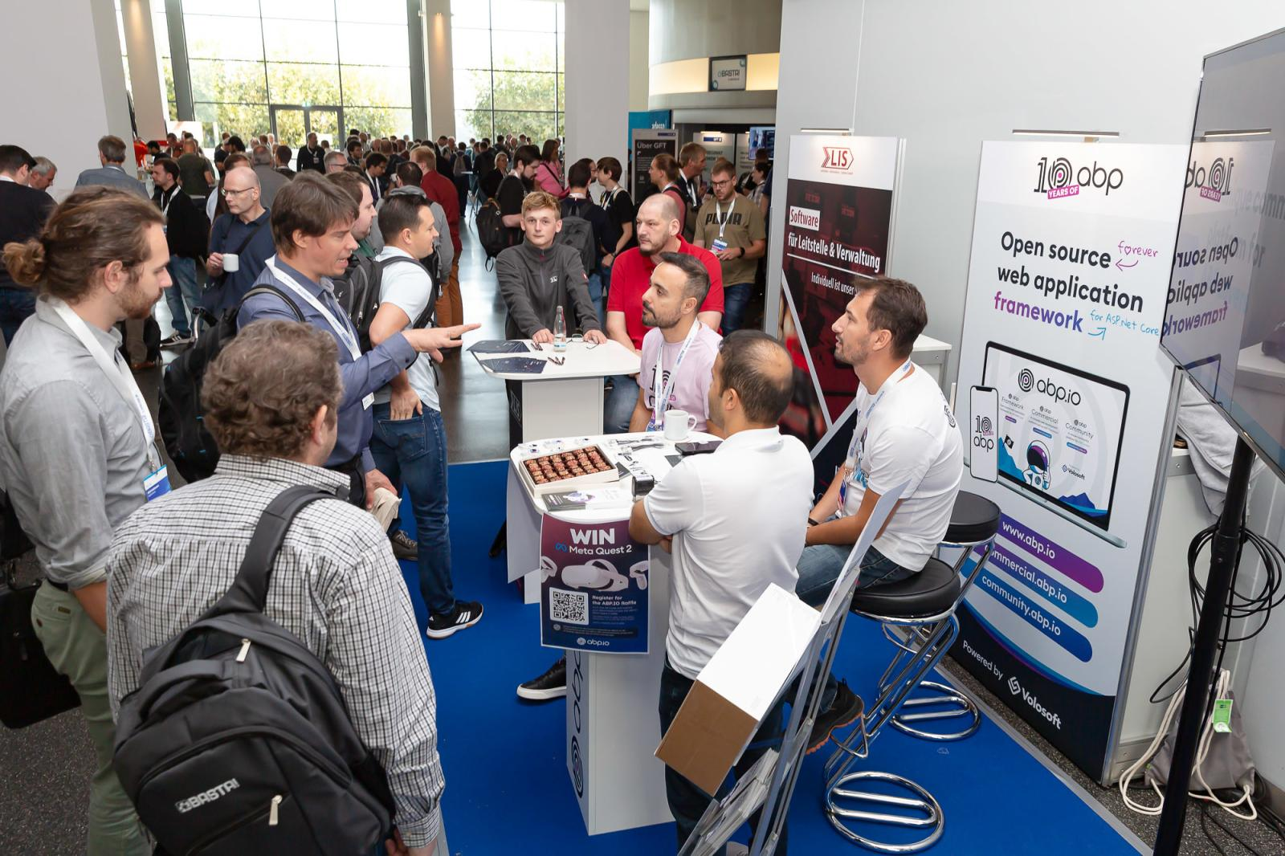
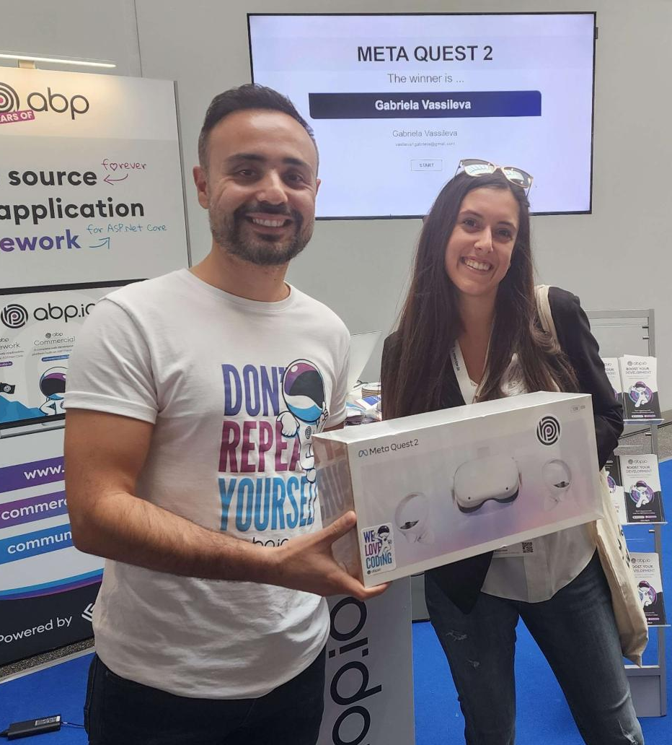
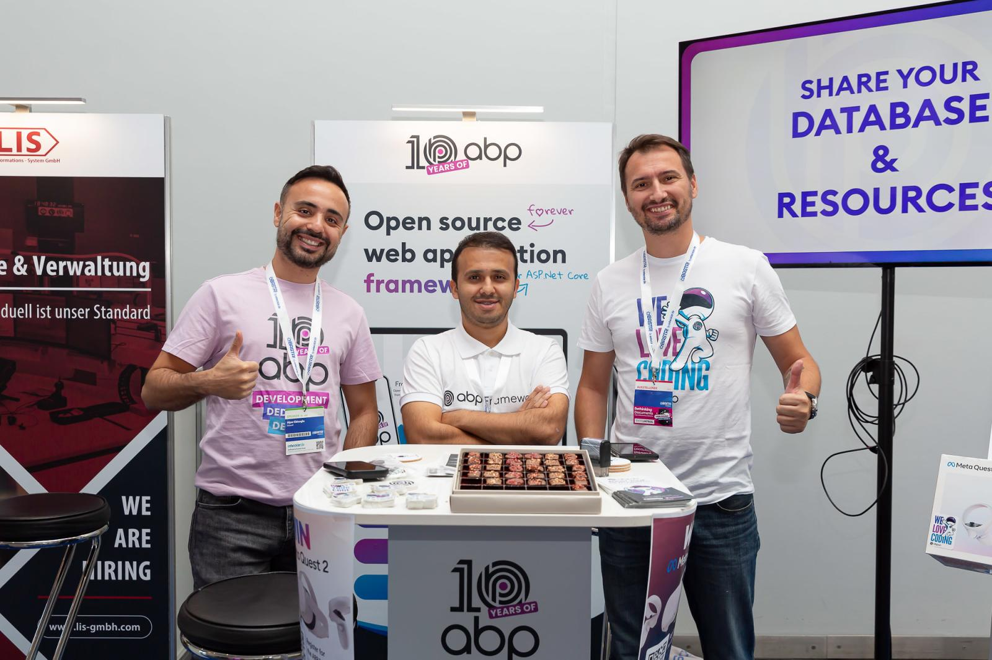
ABP Sponsoring 👉 BASTA Conference 🌍 Germany
https://abp.io/blog/Catch-Us-At-BASTA-Frankfurt-2025
Notes:
Ismail will talk about Modular Monolith Development with ASP.NET Core and ABP Framework

Slide 10
What’s new with ABP?

Slide 11
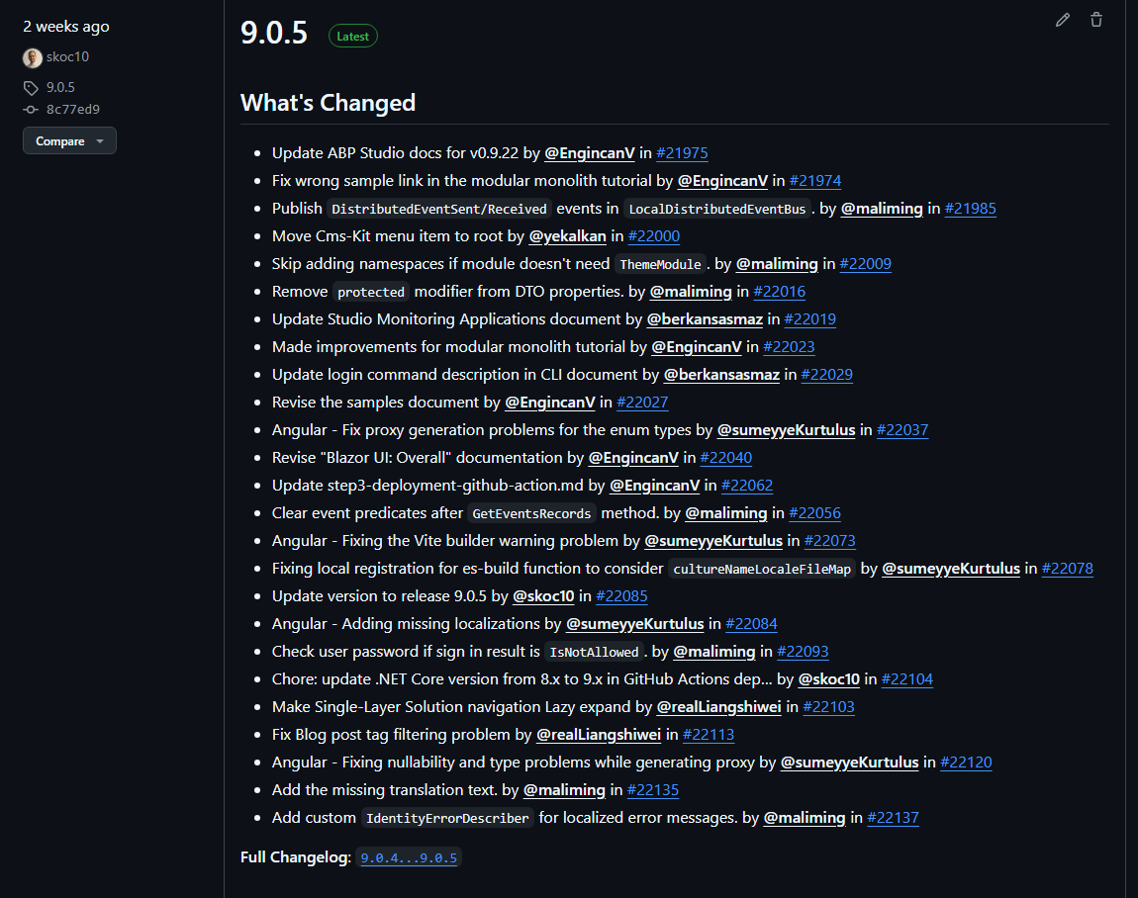
ABP 9.0.5 Patch Version Published ✔
ABP 9.0.6
Coming
Next Week
(March 6)
👉

Slide 12
Upcoming major version: ABP 9.1.0
Expected release date 11 March
🔶 LocalDistributedEventBus with Outbox/Inbox Pattern
🔸Support for the outbox/inbox patterns in LocalDistributedEventBus, improving reliability in distributed event handling.
🔶 Improved Permission Management
🔸A major refactor in the permission management system now ensures that the "Grant All Permissions" feature works better.
🔶 Angular Fixes & Enhancements
🔸Fixes for ESLint dependency issues.
🔸Resolution of tree node selection bugs.
🔸Proxy generation improvements, especially for enums and nullability checks.
🔸Updated templates to align with Angular 19.1.x.
🔶 Localization Enhancements
🔸Custom IdentityErrorDescriber now provides better localized error messages, improving user experience for multilingual applications.
🔶 Database & Dependency Updates
🔸Updated Pomelo.EntityFrameworkCore.MySql and Npgsql.EntityFrameworkCore.PostgreSQL to latest versions.
🔸OpenIddict: Upgraded to version 6.0.0 for better authentication support
🔶 Documentation Improvements
🔸Breadcrumbs and toolbar items now reset properly when disposing pages.
🔸Updated CLI documentation with improved descriptions.
🔸Enhanced Blazor UI and modular monoliths documentations
🔶 Other Notable Improvements
🔸Fixed filtering issues in permission modals.
🔸Added support for Tencent Cloud SMS.
🔸Enhanced comment time formatting with localized "time ago" display.
🔸Various bug fixes and performance optimizations.
Notes:
Key Highlights in 9.1
🔹 LocalDistributedEventBus with Outbox/Inbox Patterns
ABP 9.1 introduces support for the outbox/inbox patterns in LocalDistributedEventBus, improving reliability in distributed event handling.
🔹 Improved Permission Management
A major refactor in the permission management system now ensures that the "Grant All Permissions" feature works as expected, making permission handling more seamless.
🔹 Angular Fixes & Enhancements
Several updates target Angular, including:
Fixes for ESLint dependency issues.
Resolution of tree node selection bugs.
Proxy generation improvements, especially for enums and nullability checks.
Updated templates to align with Angular 19.1.x.
🔹 Localization Enhancements
Custom IdentityErrorDescriber now provides better localized error messages, improving user experience for multilingual applications.
🔹 Database & Dependency Updates
Entity Framework Core: Updated Pomelo.EntityFrameworkCore.MySql and Npgsql.EntityFrameworkCore.PostgreSQL to latest versions.
OpenIddict: Upgraded to version 6.0.0 for better authentication support.
🔹 Improved UI & Documentation
Page header improvements: Breadcrumbs and toolbar items now reset properly when disposing pages.
Updated CLI documentation with improved descriptions.
Enhanced documentation across various features, including Blazor UI and modular monoliths.
🛠 Other Notable Improvements
Fixed filtering issues in permission modals.
Added support for Tencent Cloud SMS.
Enhanced comment time formatting with localized "time ago" display.
Various bug fixes and performance optimizations.
ABP 9.1 is packed with updates that make development smoother and more efficient. Upgrade now and take advantage of these improvements!

Slide 13
Upcoming major version: ABP 9.1.0 PRO
Expected release date 11 March
🔶 Security & Authentication
– Improved token lifetime validation.
– Revoking session when switching users.
– Added idle session warnings for Blazor and Angular.
– Option to force-enable PKCE in OpenIddict.
– Encryption of secret settings for security.
🔶 Blazor & MVC Improvements
– Enhanced support for Blazor WebAssembly bundling.
– Fixes for Blazor entity creation and repository generation.
– Mobile UI/UX enhancements for Blazor and MVC.
– Unification of the bundling system for Blazor and MVC.
🔶 Angular Enhancements
– Fixed organization unit selection issues.
– UI updates for user detail modal, menu contributors, and sessions page.
– Resolved Eslint dependency and validation issues.
– Upgraded to Angular 19.x for improved performance.
– Adjusted navbar and security logs redirection.
🔶 Suite & SaaS Updates
– Fixes for Suite default values and data table overflow issues.
– Improved connection string management with an option to disable tenant-based configuration.
– Saas over-subscription prevention.
– Adjusted menu contributors for CMSKit & SaaS.
🔶 File & Media Handling
– Fixed profile picture upload issues.
– Improved file upload support.
🔶 Quality of Life Improvements
– Refactored input fields to improve accessibility.
– Improved localization texts.
– Sorting enhancements (default sort by creation time).
– Added permissions for dynamic menu items.
🔶 Technical Updates
– Upgraded GitHub Actions cache and test environment.
– Updated Dockerfile for Blazor deployment.
– Upgraded Iyzico NuGet packages.

Slide 14
Studio Updates
User login via abp.io website
Upgraded ABP Studio to .NET 9
Auto-installing prerequisites when installing ABP Studio
Feature to add services while creating microservice solutions
Fixed problems on generated Docker files after project creation
Fixed problems with Readme files, after creating a new project

Slide 15




That’s all from me ☺
Follow me on Twitter
Alper Ebicoglu
https://twitter.com/alperebicoglu
https://github.com/ebicoglu
https://medium.com/@alperonline

